Slide 1
Pesticides in New York: from 1997 to 2023
Michelle Cao
February 18, 2025

Slide 2
Agenda
Research Question
About the data + retrieval
Exploratory data analysis (EDA)
Variables
Cleaning
Maps/plots
Relevance to stakeholders
Ethical/legal/societal implications

Slide 3
Research Question
What does the pesticide landscape look like in New York?
What socio/economic factors (if any) contribute to pesticide usage?
Do they cause any harm to us (humans) directly and indirectly?
To address this question, we need to examine:
Extent
Intensity
Quality
Pesticide patterns

Slide 4

About the data + retrieval
Pesticides Sales and Use Reporting from Cornell University Cooperative Extension (in .csv format)
Zip code level from 1997 to 2023
US Census Data (zip code level)
Pesticide Usage
year, weight_qty (dry), volume_qty (wet), number of pesticides used, zip code
Pesticide Sales
year, weight_qty (dry), volume_qty (wet), number of pesticides used, zip code
Census data (zip codes)
zip code, socioeconomic data, etc.

Slide 5
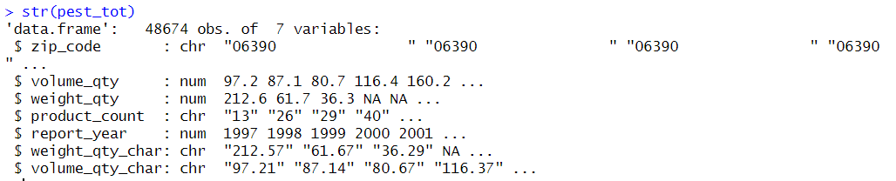
Exploratory Data Analysis
Data Cleaning – change vars to numerical, make it tidy
Plots – examine insecticide quantity applied over time
Summary Stats – aggregate by zip code, sum total pesticides & quantities
Map – join to census shapefile and create graduated colors map

Slide 6
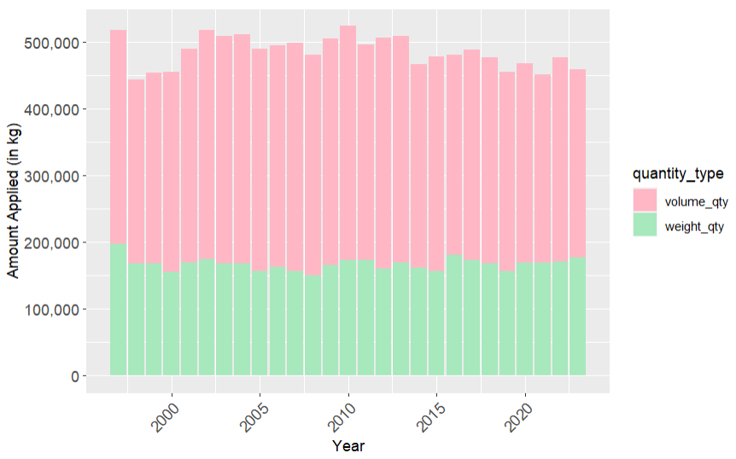
Total Pesticides Applied from 1997 to 2023 in NY

Slide 7
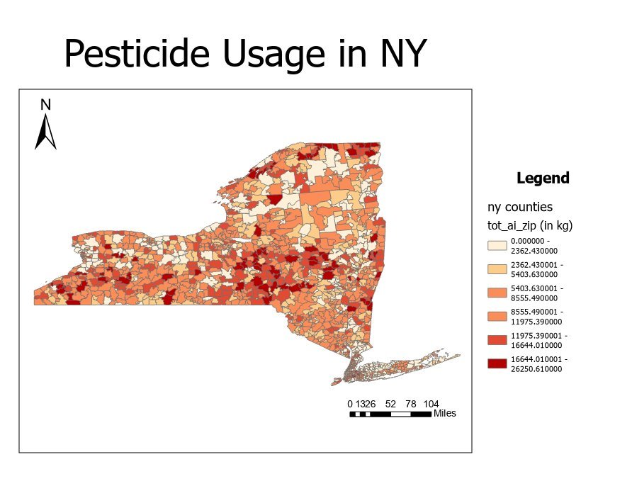

Slide 8
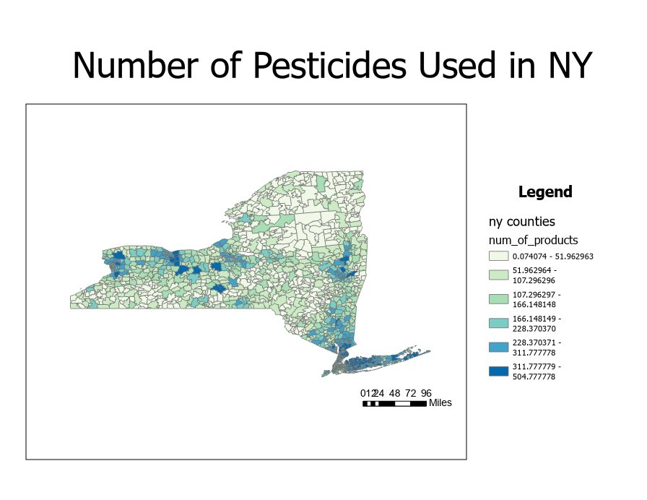
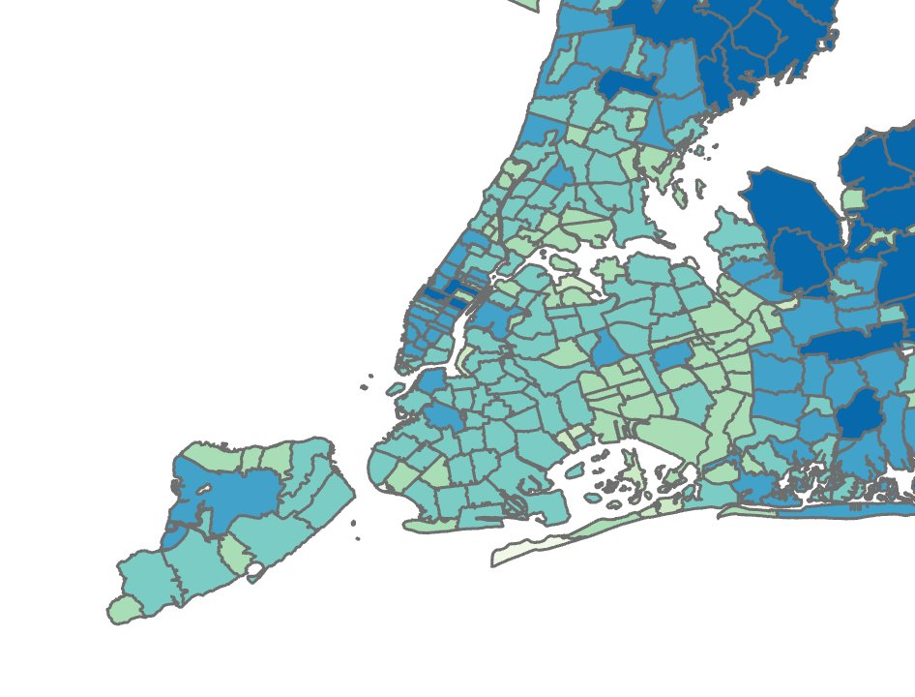
Zoomed in version of NYC

Slide 9
Relevance to stakeholders
Researchers: lots of work done in agricultural pesticides but missing info on urban and forest land covers
Environmental Agencies/Nonprofits: pesticides = non target impacts on wildlife and the environment
Policymakers: inform decisions on a state/federal level to reduce harm
Public (aka us!): pesticide residue in our food/water/etc. is a big issue - awareness + knowledge is key!

Slide 10
Ethical, legal, societal implications
Ethical
Reduce impacts to non-target organisms
Legal
Tracking pesticide data = transparency and accountability from policymakers
Accessibility of data (public portal)
Societal
Knowledge/awareness of pesticide patterns
Data and resources to support grassroots change

Slide 11
Thanks for listening!
Questions?

